Slide 1
Snowflake
DW on cloud

Slide 2
Snowflake
Snowflake is an analytic data warehouse provided as Software-as-Services(SaaS). Snowflake provides data warehouse that is faster, easier to use and more flexible that other traditional data warehouses.
Snowflake data warehouse is not built on existing databases or not on big data software platform as Hadoop.
The snowflake data warehouse uses a new SQL database engine with unique architecture designed for the cloud.

Slide 3
Key Concept and Architecture
Data Warehouse as Cloud Service:
Snowflake data warehouse is true SaaS offering.
• There is no hardware (virtual or physical) for you to select, install, configure and manage.
• There is no software for you install, configure and manage.
• Ongoing maintenance, management and tuning is handled by snowflake.
Snowflake completely runs on cloud infrastructure. All the component of the snowflake service runs on public cloud infrastructure.
Snowflake uses virtual compute instance for its compute need and storage service for storage of data. Snowflake can not be run on private cloud infrastructure(on-premises)

Slide 4
Snowflake architecture is the combination of shared-disk database architecture and shared-nothing database architecture.
Shared-disk database architecture:
Snowflake uses central repository for data storage that is accessible from all the compute nodes in the data warehouse.
Sharing-nothing architecture:
Snowflake processes queries using Massively Parallel Processing(MPP) compute cluster where each nodes in compute cluster stores a portion of the entire data set locally.

Slide 5
Shared-Disk | Shared-Nothing
Expensive hardware with redundancy to handle component failure | Typically built on commodity hardware
High availability | Node availability is low and system availability is high
Relatively low scalability | High Scalability
Preferred in OLTP systems that require ACID compliance | Preferred in an environment with high, read/write rates
Data is partitioned and striped but within the storage array | Data may be partitioned and distributed across the cluster

Slide 6
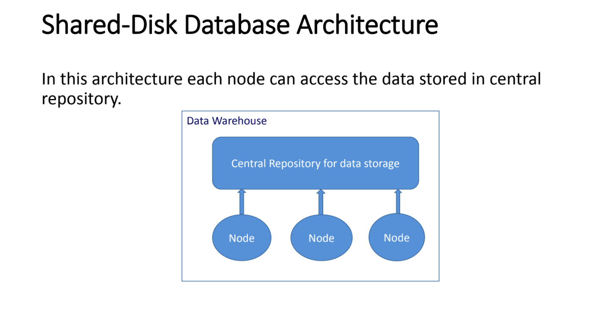

Slide 7
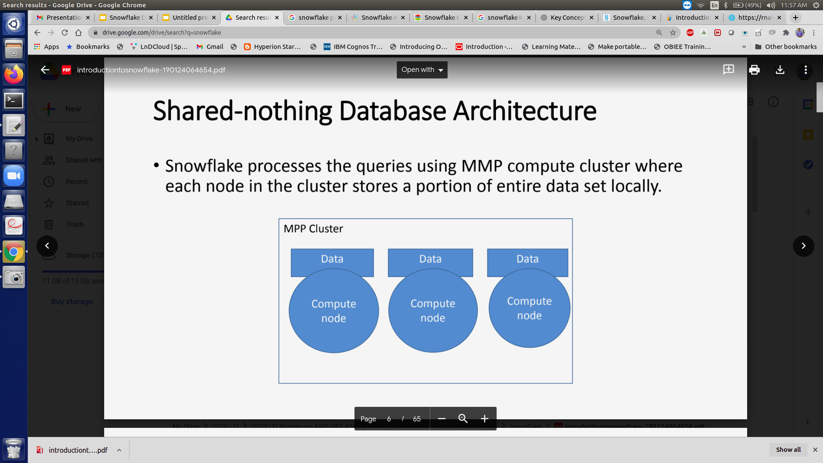

Slide 8
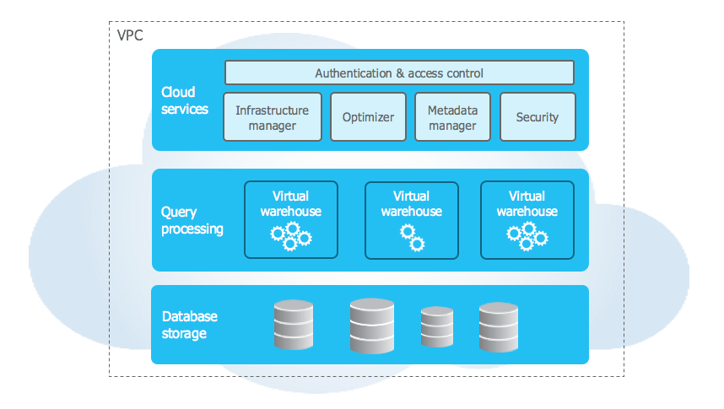
Snowflake Architecture

Slide 9
Database Storage
When data is loaded into Snowflake, Snowflake reorganizes that data into its internal optimized, compressed, columnar format. Snowflake stores this optimized data in cloud storage.
Snowflake manages all aspects of how this data is stored — the organization, file size, structure, compression, metadata, statistics, and other aspects of data storage are handled by Snowflake. The data objects stored by Snowflake are not directly visible nor accessible by customers; they are only accessible through SQL query operations run using Snowflake.

Slide 10
Query Processing
Query execution is performed in the processing layer. Snowflake processes queries using “virtual warehouses”. Each virtual warehouse is an MPP compute cluster composed of multiple compute nodes allocated by Snowflake from a cloud provider.
Each virtual warehouse is an independent compute cluster that does not share compute resources with other virtual warehouses. As a result, each virtual warehouse has no impact on the performance of other virtual warehouses.

Slide 11
Cloud Services
The cloud services layer is a collection of services that coordinate activities across Snowflake. These services tie together all of the different components of Snowflake in order to process user requests, from login to query dispatch. The cloud services layer also runs on compute instances provisioned by Snowflake from the cloud provider.
Services managed in this layer include:
Authentication
Infrastructure management
Metadata management
Query parsing and optimization
Access control

Slide 12
Connecting to Snowflake
Snowflake supports multiple ways of connecting to the service:
A web-based user interface from which all aspects of managing and using Snowflake can be accessed.
Command line clients (e.g. SnowSQL) which can also access all aspects of managing and using Snowflake.
ODBC and JDBC drivers that can be used by other applications (e.g. Tableau) to connect to Snowflake.
Native connectors (e.g. Python, Spark) that can be used to develop applications for connecting to Snowflake.
Third-party connectors that can be used to connect applications such as ETL tools (e.g. Informatica) and BI tools (e.g. ThoughtSpot) to Snowflake.

Slide 13
Snowflake is provided as Software-as-a-Service (SaaS) that runs completely on cloud infrastructure. This means that all three layers of Snowflake’s architecture (storage, compute, and cloud services) are deployed and managed entirely on a selected cloud platform.
A Snowflake account can be hosted on any of the following cloud platforms:
Amazon Web Services (AWS)
Google Cloud Platform (GCP)
Microsoft Azure (Azure)
If your organization’s other cloud services are already hosted on one of these platforms, you can choose to host all your Snowflake accounts on the same platform. However, you can also choose to host your accounts on a different platform.

Slide 14
Snowflake Editions
Standard Edition
Standard Edition is our introductory level offering, providing full, unlimited access to all of Snowflake’s standard features. It provides a strong balance between features, level of support, and cost.
Enterprise Edition
Enterprise Edition provides all the features and services of Standard Edition, with additional features designed specifically for the needs of large-scale enterprises and organizations.
Business Critical Edition
Business Critical Edition, formerly known as Enterprise for Sensitive Data (ESD), offers even higher levels of data protection to support the needs of organizations with extremely sensitive data, particularly PHI data that must comply with HIPAA and HITRUST CSF regulations.
It includes all the features and services of Enterprise Edition, with the addition of enhanced security and data protection. In addition, database failover/failback adds support for business continuity and disaster recovery.

Slide 15
Virtual Private Snowflake (VPS)
Virtual Private Snowflake offers our highest level of security for organizations that have the strictest requirements, such as financial institutions and any other large enterprises that collect, analyze, and share highly sensitive data.
It includes all the features and services of Business Critical Edition, but in a completely separate Snowflake environment, isolated from all other Snowflake accounts (i.e. VPS accounts do not share any resources with accounts outside the VPS).
https://docs.snowflake.com/en/user-guide/intro-editions.html#security-governance-data-protection

Slide 16
DATA LOADING

Slide 17
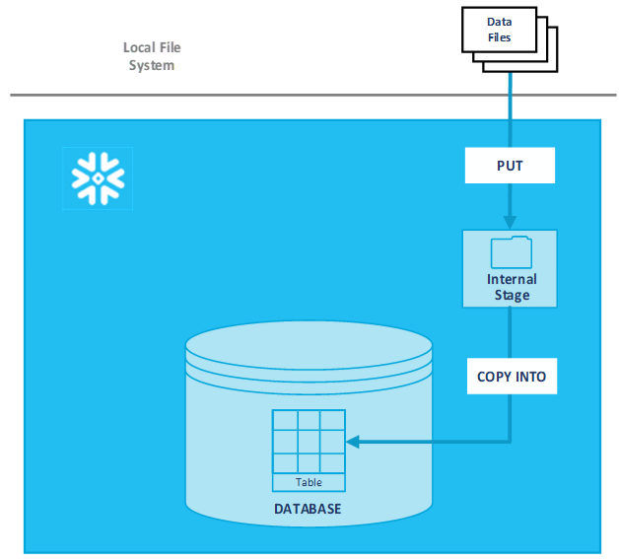

Slide 18
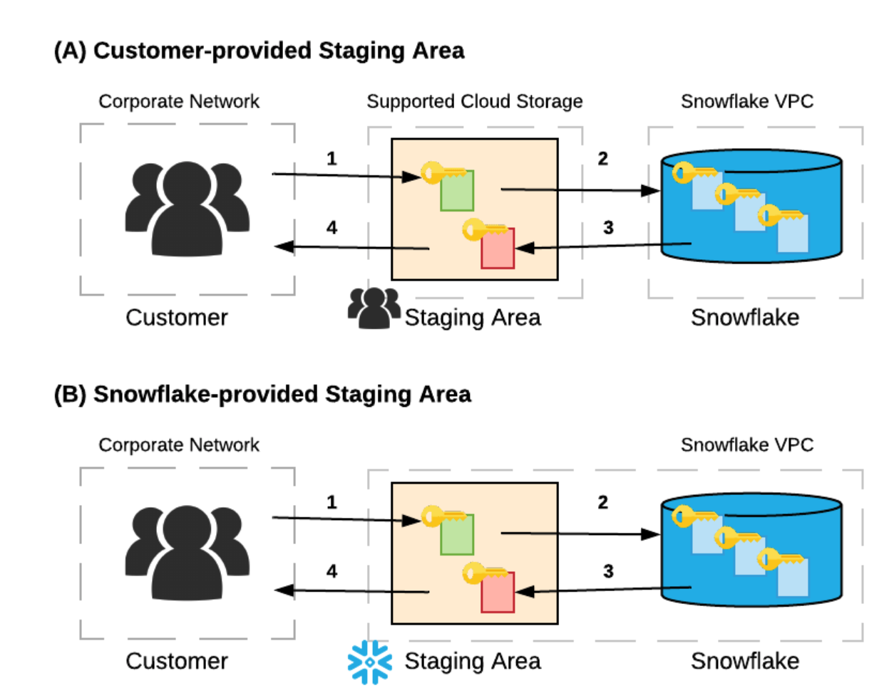

Slide 19
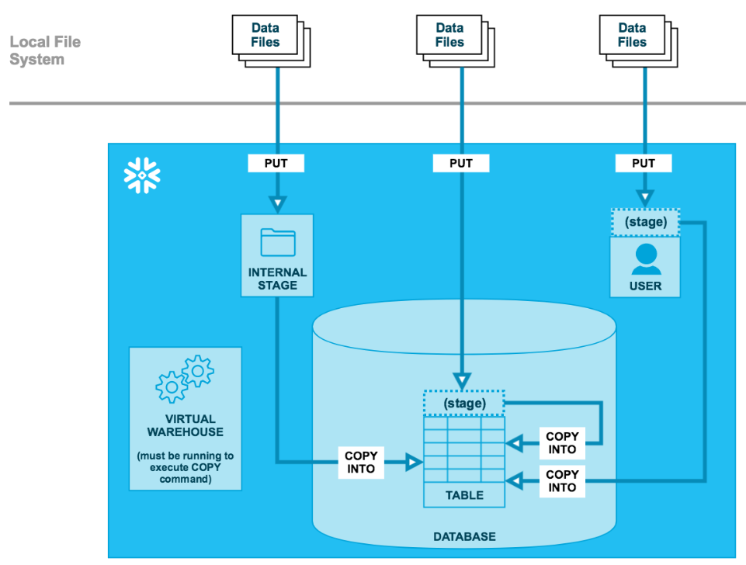

Slide 20
